Slide 1
Python API
Tanya Sattaya-aphitan, Ph.D.
Oct 6-7, 2020 @การยางแห่งประเทศไทย

Slide 2
Agenda
Day 1
Overview & Installation
Basic Python
Call API :
BOT: Exchange Rate
AI : AI 4 Thai
Day 2
Working with Database : MySQL
Create Your First API
Create API with Django framework

Slide 3
API Overview

Slide 4
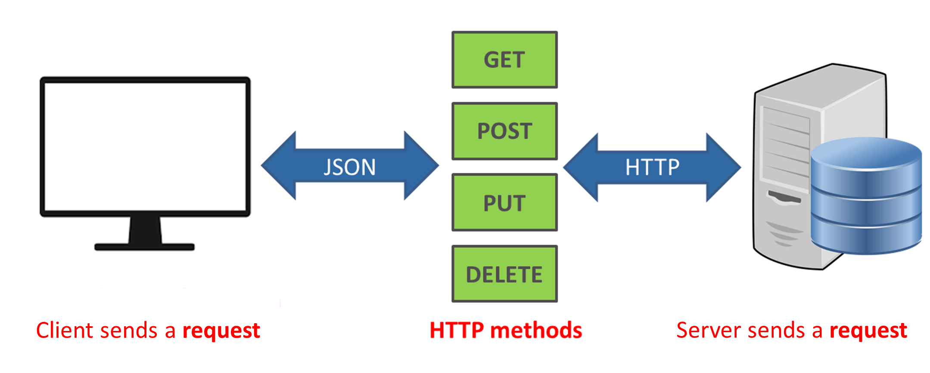
API = Application Program Interface
Img src: https://www.dailytech.in.th/api-%E0%B8%84%E0%B8%B7%E0%B8%AD%E0%B8%AD%E0%B8%B0%E0%B9%84%E0%B8%A3/

Slide 5
API vs Web Service
API = Application Program Interface
Web Service = API (operate over HTTP)
All Web Services = API
In this course !
API = Web Service
API
Web Service
(HTTP)
cobra
com
proprietary

Slide 6
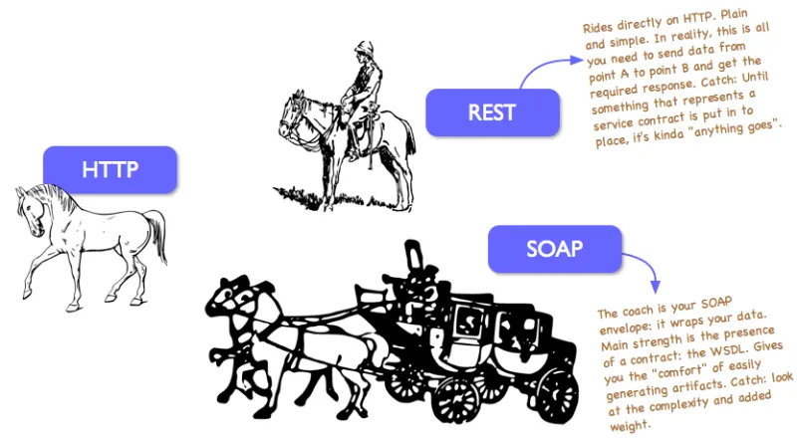
SOAP & REST
SOAP (Simple Object Access Protocol) - Standard
REST (REpresentational State Transfer) - Data
More Information https://rapidapi.com/blog/types-of-apis/

Slide 7
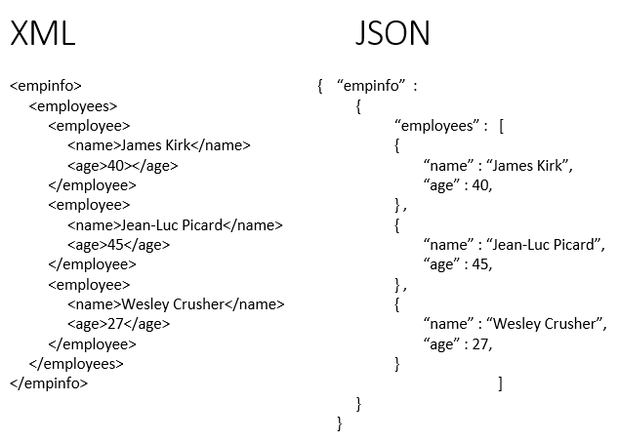
SOAP REST

Slide 8
Installation

Slide 9
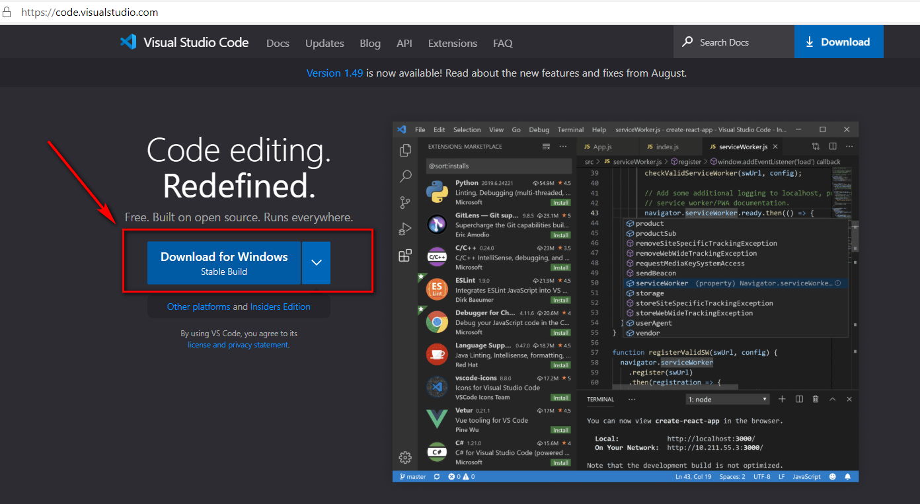
IDE: Visual Studio Code

Slide 10
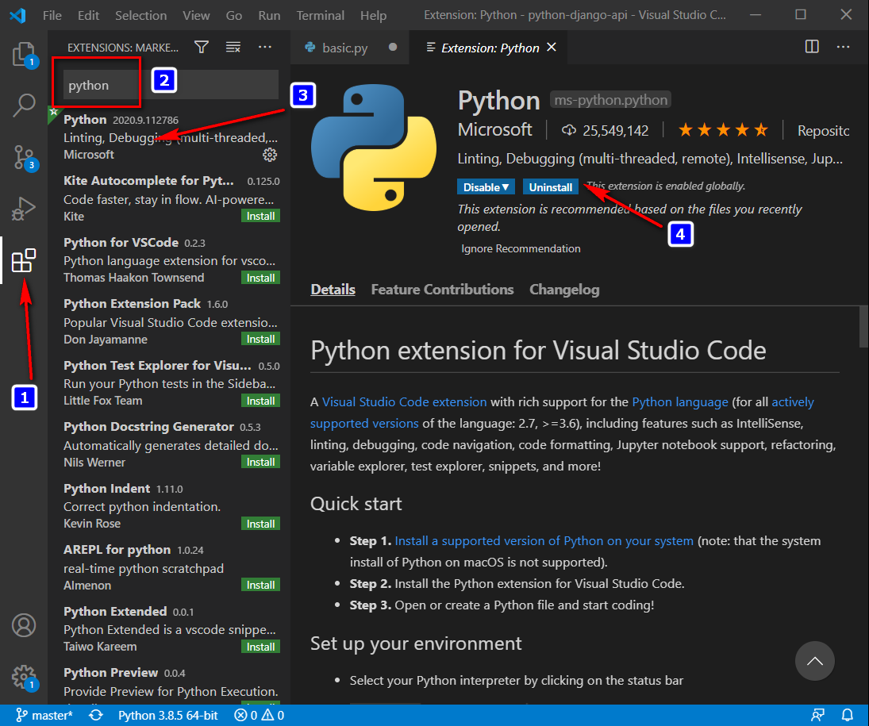
IDE : Plugin python

Slide 11
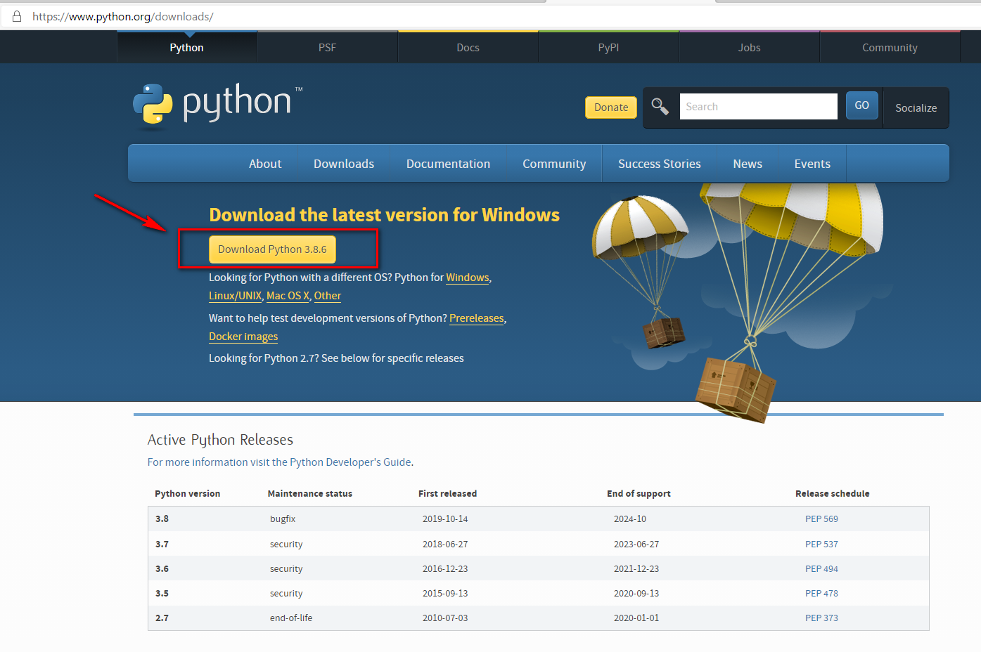
Python
python --version
Python 3.8.6

Slide 12
Python Library
pip install flask
pip install django
pip install djangorestframework
pip install django-cors-headers
flask
django
Djangorestframework
django-cors-headers
Check Version
python -m django --version
3.1.2
python -m flask --version
Python 3.8.5
Flask 1.1.2
Werkzeug 1.0.1

Slide 13
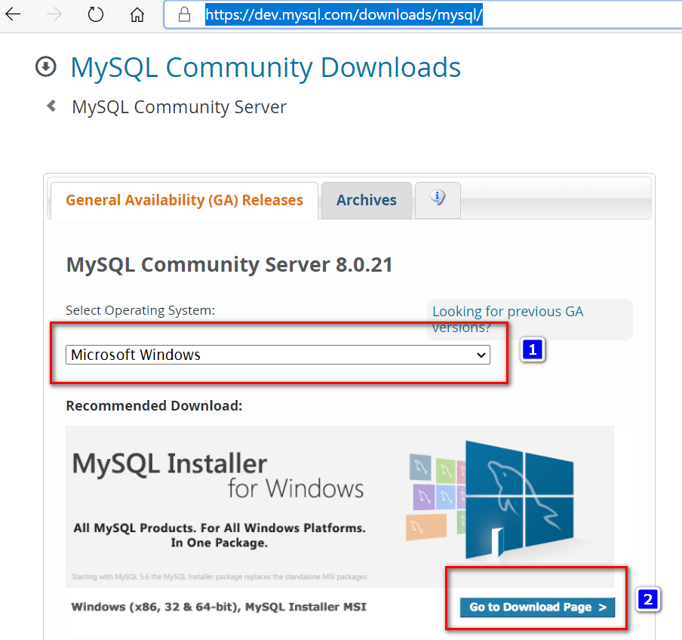
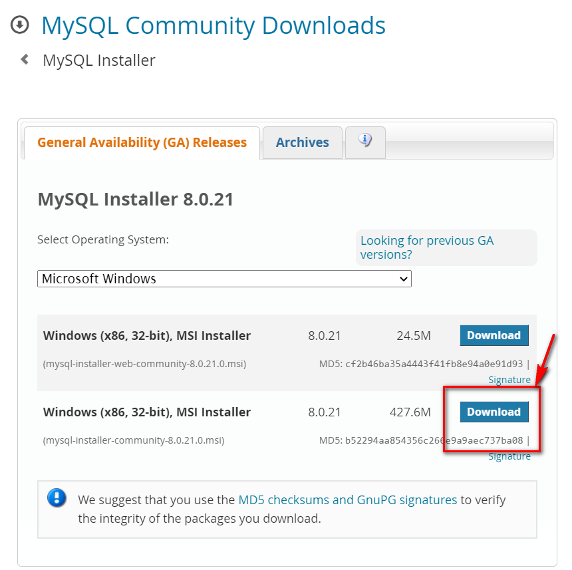
Database : MySQL Community Server
https://dev.mysql.com/downloads/mysql/

Slide 14
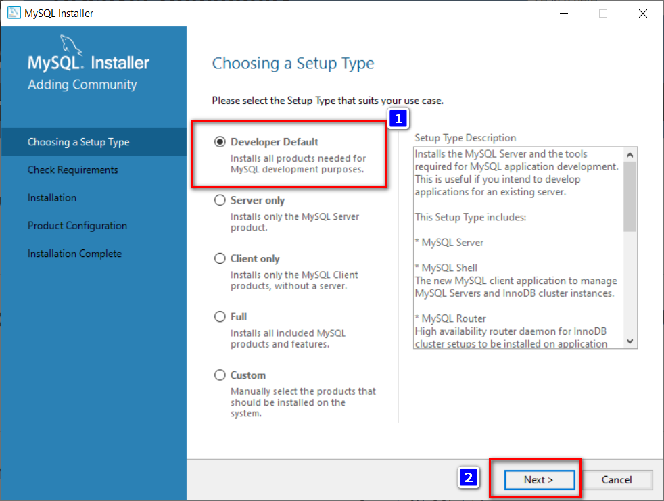
Install : developer -> next -> next

Slide 15
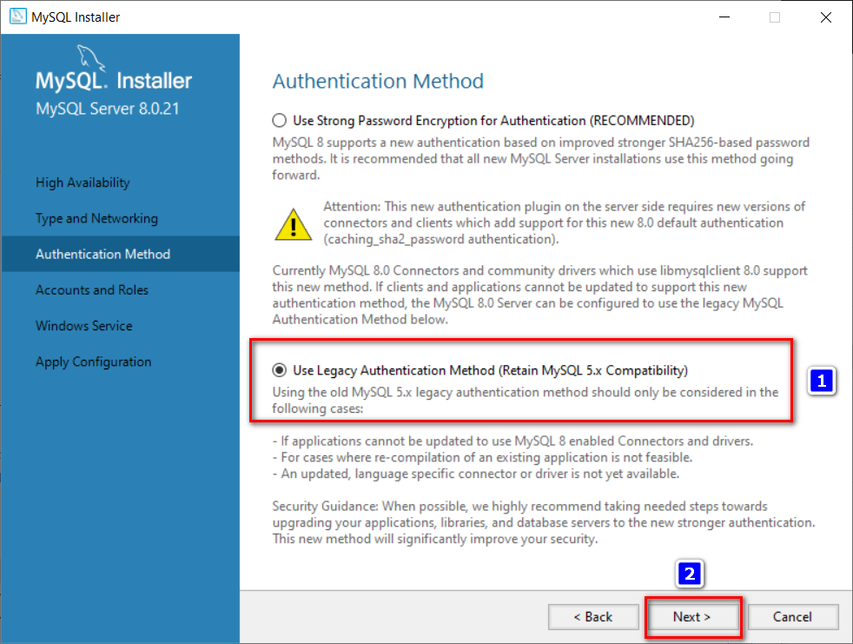
Use Legacy

Slide 16
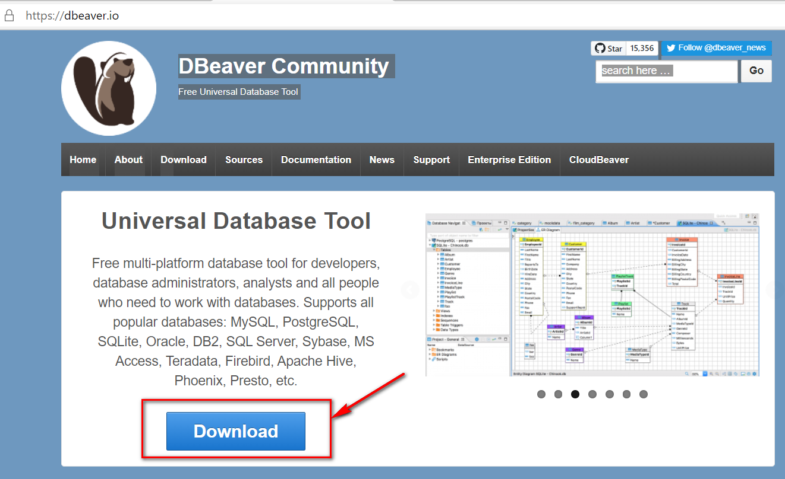
DB GUI : DBeaver Community

Slide 17
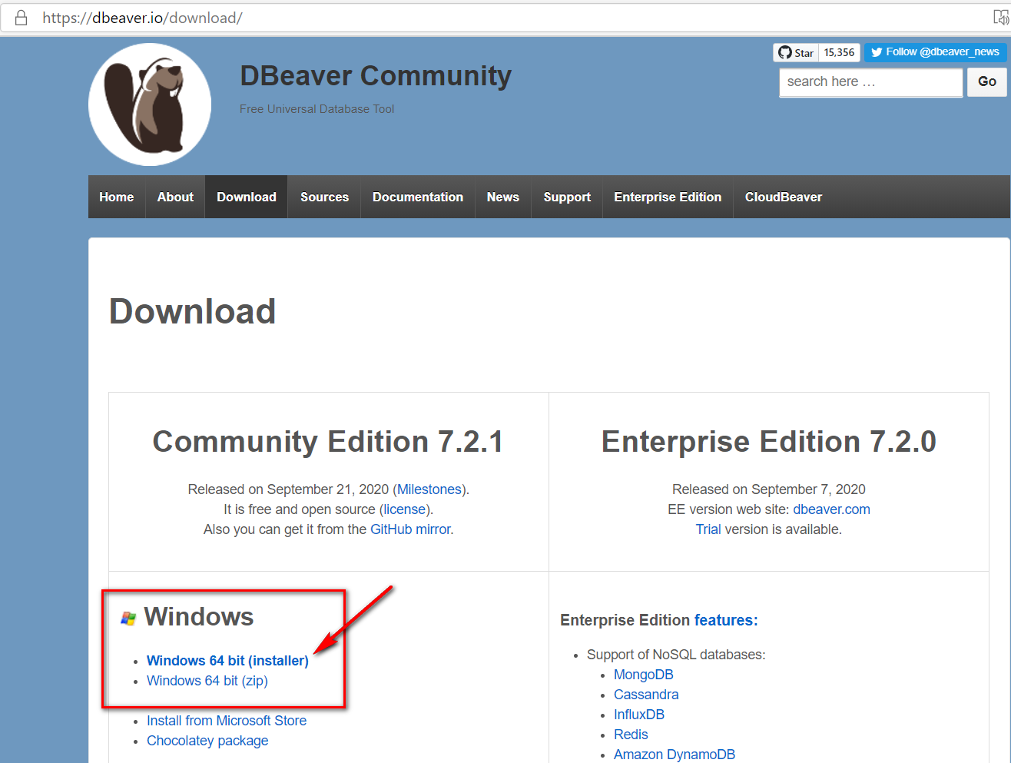
Download & Install

Slide 18
Basic Python

Slide 19
Data Types

Slide 20
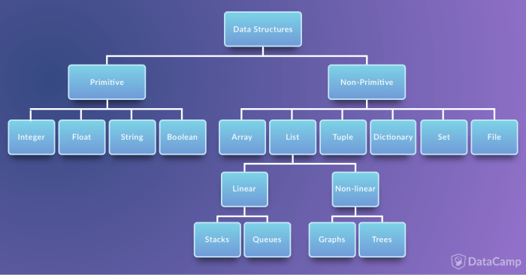
Python Variables
Source: datacamp.com

Slide 21
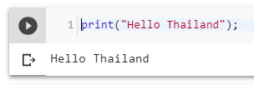
Print
Hello.py
print("Hello Thailand");
python Hello.py

Slide 22
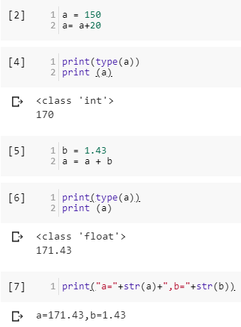
Primitive type
a = 150
a= a+20
print(type(a))
print (a)
b = 1.43
a = a + b
print(type(a))
print (a)
print("a="+str(a)+",b="+str(b))

Slide 23
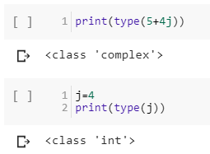
Complex Type
print(type(5+4j))
j=4
print(type(j))

Slide 24
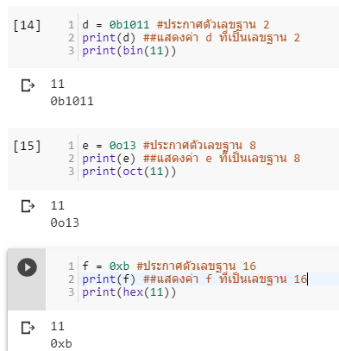
Complex : Binary Octal Hexa
d = 0b1011 #ประกาศตัวเลขฐาน 2
print(d) ##แสดงค่า d ที่เป็นเลขฐาน 2
print(bin(11))
e = 0o13 #ประกาศตัวเลขฐาน 8
print(e) ##แสดงค่า e ที่เป็นเลขฐาน 8
print(oct(11))
f = 0xb #ประกาศตัวเลขฐาน 16
print(f) ##แสดงค่า f ที่เป็นเลขฐาน 16
print(hex(11))

Slide 25
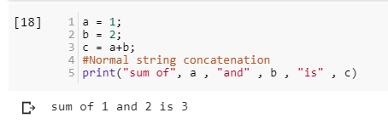
Concat String with Int
a = 1;
b = 2;
c = a+b;
#Normal string concatenation
print("sum of", a , "and" , b , "is" , c)

Slide 26
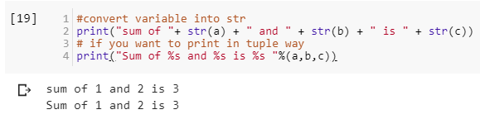
Concat String with Int (cont)
#convert variable into str
print("sum of "+ str(a) + " and " + str(b) + " is " + str(c))
# if you want to print in tuple way
print("Sum of %s and %s is %s "%(a,b,c))
print("Sum of {0} and {1} is {2} ".format(a,b,c))

Slide 27
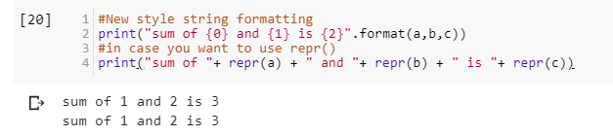
Concat String with Int (cont)
#New style string formatting
print("sum of {0} and {1} is {2}".format(a,b,c))
#in case you want to use repr()
print("sum of "+ repr(a) + " and "+ repr(b) + " is "+ repr(c))

Slide 28
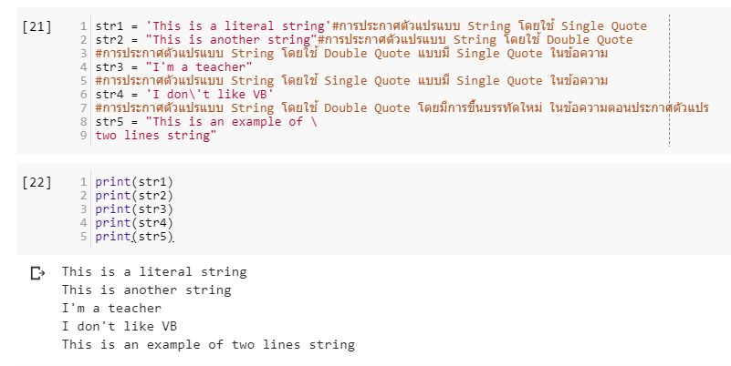
String
str1 = 'This is a literal string'#การประกาศตัวแปรแบบ String โดยใช้ Single Quote
str2 = "This is another string"#การประกาศตัวแปรแบบ String โดยใช้ Double Quote
#การประกาศตัวแปรแบบ String โดยใช้ Double Quote แบบมี Single Quote ในข้อความ
str3 = "I'm a teacher"
#การประกาศตัวแปรแบบ String โดยใช้ Single Quote แบบมี Single Quote ในข้อความ
str4 = 'I don\'t like VB'
#การประกาศตัวแปรแบบ String โดยใช้ Double Quote โดยมีการขึ้นบรรทัดใหม่ ในข้อความตอนประกาศตัวแปร
str5 = "This is an example of \
two lines string"

Slide 29
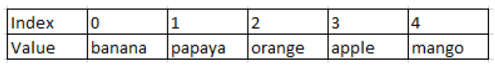
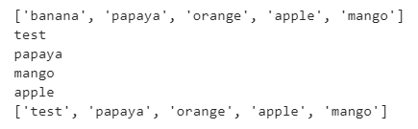
List (Array)
fruits = ["banana","papaya",
"orange","apple","mango"]
print(fruits)
fruits[0] = "test"
print(fruits[0])
print(fruits[1])
print(fruits[-1])
print(fruits[-2])
print(fruits)
#add data to List
fruits.append('pen')
print(fruits)

Slide 30
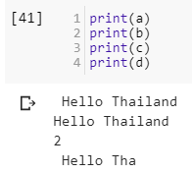
Functions
a = " Hello Thailand "
b = a.strip() #ตัด White Space
c = a.count('a') #นับว่ามี a กี่ตัวใน 1 คำ
#slicing index เริ่มที่ 0
e = a[0:10] #เป็นการ slice ตั้งแต่ 0-9 แต่ไม่รวม 10 (exclusion)

Slide 31
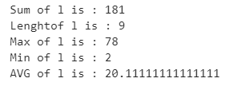
Statistic Functions
!pip install statistics
import statistics
l = [15, 18, 2, 36, 12, 78, 5, 6, 9]
print("Sum of l is : "+ str(sum(l)))
print("Length of l is : "+ str(len(l)))
print("Max of l is : "+ str(max(l)))
print("Min of l is : "+ str(min(l)))
print("AVG of l is : "+ str(sum(l) / float(len(l))))

Slide 32
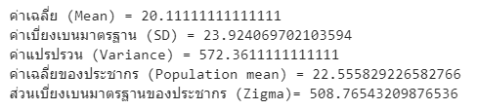
Statistic Functions
print("ค่าเฉลี่ย (Mean) = "+ str(statistics.mean(l)))
print("ค่าเบี่ยงเบนมาตรฐาน (SD) = "+ str(statistics.stdev(l)))
print("ค่าแปรปรวน (Variance) = "+ str(statistics.variance(l)))
print("ค่าเฉลี่ยของประชากร (Population mean) = "+ str(statistics.pstdev(l)))
print("ส่วนเบี่ยงเบนมาตรฐานของประชากร (Zigma)= "+ str(statistics.pvariance(l)))

Slide 33
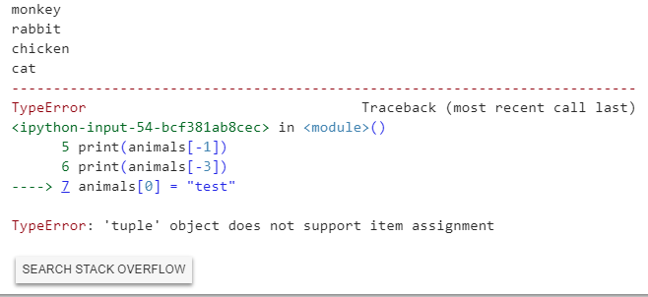
Tuple -- data cannot be changed
animals = ("monkey","rabbit", "cat", "kangaroo","chicken")
print(animals[0])
print(animals[1])
print(animals[-1])
print(animals[-3])
animals[0] = "test" #cannot change

Slide 34
Dictionary
data = {
'day':['1/1/2018','2/1/2018','3/1/2018'],
'temp':[20,10,15],
'event':['cold','cold','cold']
} #สร้างข้อมูล
print(data['day'])
#เพิ่มข้อมูล
data['x']=[1,2,3]
print(data)

Slide 35
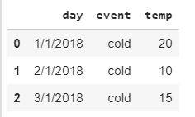
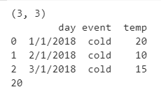
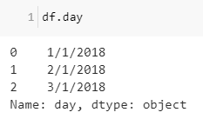
Data Frame
import pandas as pd #Import pandas
data = {
'day':['1/1/2018','2/1/2018','3/1/2018'],
'temp':[20,10,15],
'event':['cold','cold','cold']
} #สร้างข้อมูล
df= pd.DataFrame(data)
print(df.shape) #ดูขนาดข้อมูล
print(df) #แสดงข้อมูลที่อยู่ใน DataFrame
print(df['temp'].max())
df.day
df['day']

Slide 36
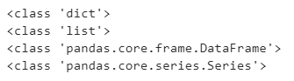
Data Frame
print(type(data))
print(type(data['temp']))
print(type(df))
print(type(df.temp))

Slide 37
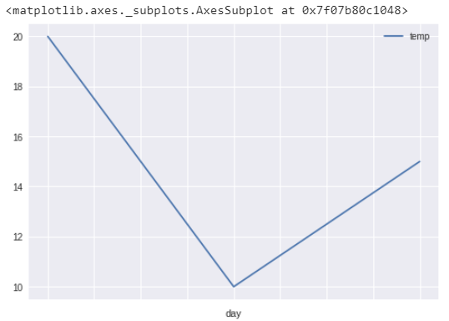
Plot graph (change index)
df.set_index('day',inplace=True)
df.sort_index()
df.plot()

Slide 38
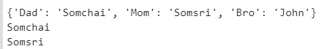
Dictionary
name={'Dad':'Somchai','Mom':'Somsri','Bro':'John'} #สร้างข้อมูลเก็บไว้ใน Dictionary
print(name) #แสดงข้อมูลเก็บไว้ใน Dictionary ที่มีชื่อว่า name
print(name['Dad']) #แสดงข้อมูลเก็บไว้ใน Dictionary ที่มีชื่อว่า name โดยมี Key คือ Dad
print(name['Mom']) #แสดงข้อมูลเก็บไว้ใน Dictionary ที่มีชื่อว่า name โดยมี Key คือ Mom

Slide 39
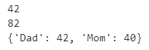
Dictionary
#ทาเช่นเดิม แต่เก็บค่าในรูปแบบ Int
age={'Dad':42,'Mom':40}
print(age['Dad'])
print(age['Dad']+ age['Mom']) #คานวณค่าที่ได้จากการเรียกข้อมูลโดยใช้ Key
print(age)

Slide 40
NumPy
import numpy as np #import numpy
a = np.array([1,2,3,4,5,6]) #สร้างข้อมูล
print(a[4]) #แสดงผลค่าที่อยู่ในตัวแปร a โดยมี index อยู่ที่ 5
print(a[3]+a[4]) #แสดงผลค่าผลบวกที่ index 3 และ 4 ในตัวแปร a

Slide 41
Control Flow

Slide 42
Control Flow
Comparison Operators
==มีค่าเท่ากับ
!=มีค่าไม่เท่ากับ
>มีค่ามากกว่า
>=มีค่ามากกว่าหรือเท่ากับ
<มีค่าน้อยกว่า
<=มีค่าน้อยกว่าหรือเท่ากับ
Indent สำคัญใน Python

Slide 43
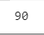
If-Else
a = 10
b = 30
c = 90
#indent
if(a == b):
print(a)
elif(a > b):
print(a)
elif(a < b):
print(c)

Slide 44
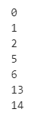
Loop
for x in range(3):
print(x)
for x in range(5, 7):
print(x)
for x in range(10, 15):
if(x > 12):
print(x)

Slide 45
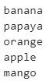
Loop over List
fruits = ["banana","papaya","orange","apple","mango"]
for fruit in fruits:
print(fruit)

Slide 46
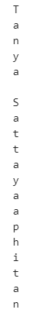
Loop over String
name = "Tanya Sattayaaphitan"
for char in name:
print(char)

Slide 47
Data Type Handling and Conversion
int(x [,base]) แปลง object x ให้เป็น integer
long (x [,base]) แปลง object x ให้เป็น long
float (X) แปลง object x ให้เป็น float
complex (real [,imag]) ทาให้เป็นตัวเลข complex
str(x) แปลง object x ให้เป็น string
repr(x) แปลง object x ให้เป็น expression string
eval(str) หาค่า string เป็น object
set (seq) แปลง sequence ให้เป็น set
frozenset(seq) แปลง sequence ให้เป็น frozenset
chr(x) แปลง integer ให้เป็น character
unichr(x) แปลง integer ให้เป็น Unicode character
ord(x) แปลง character (ตัวเดียว) ให้เป็น integer
hex (x) แปลง integer ให้เป็น hexadecimal string
oct(x) แปลง integer ให้เป็น octal string

Slide 48
Function
def plus(a,b):
c = a + b
return c
print(plus(1,2))

Slide 49
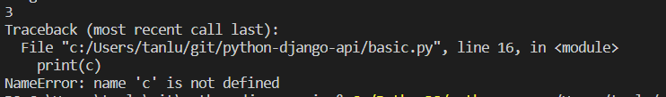
Local Variable
def plus(a,b):
c = a + b
return c
print(plus(1,2))
print(c)

Slide 50
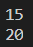
Local Variable
age = 20
def plus10(a):
age = a + 10
return age
print(plus10(5))
print(age)

Slide 51
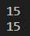
Global Variable
age = 20
def plus10(a):
global age
age = a + 10
return age
print(plus10(5))
print(age)

Slide 52
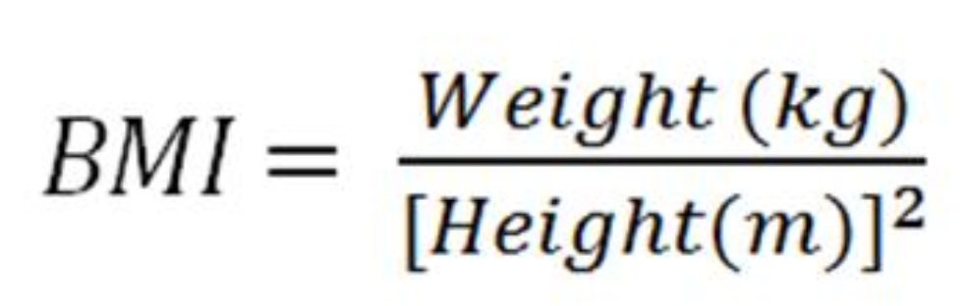
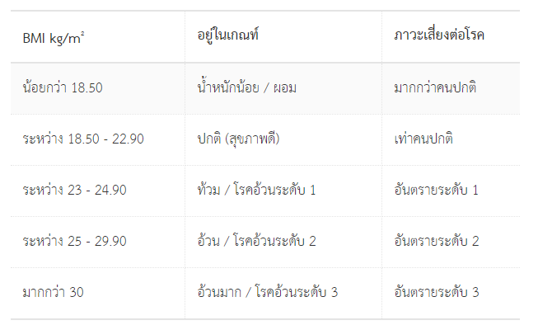
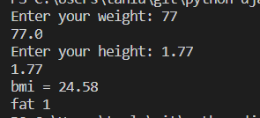
Python Lab : Write a BMI program (bmi.py)
Input weight as “kg”
Input height as “m”
177 cm = 1.77 m
Hint for Input
height = input("Enter your height: ")
height = float(height)

Slide 53
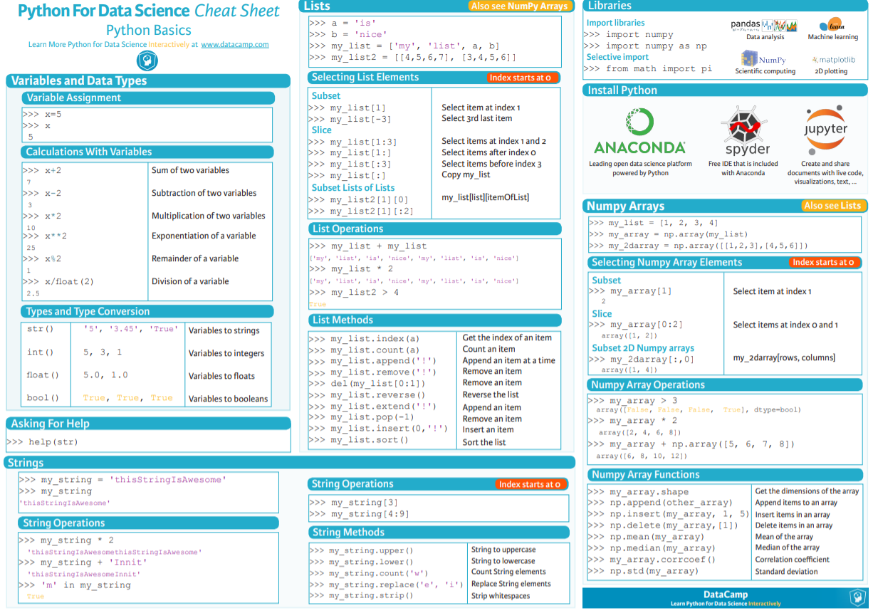
Python cheat sheet
https://s3.amazonaws.com/assets.datacamp.com/blog_assets/PythonForDataScience.pdf

Slide 54
Call BOT API

Slide 55
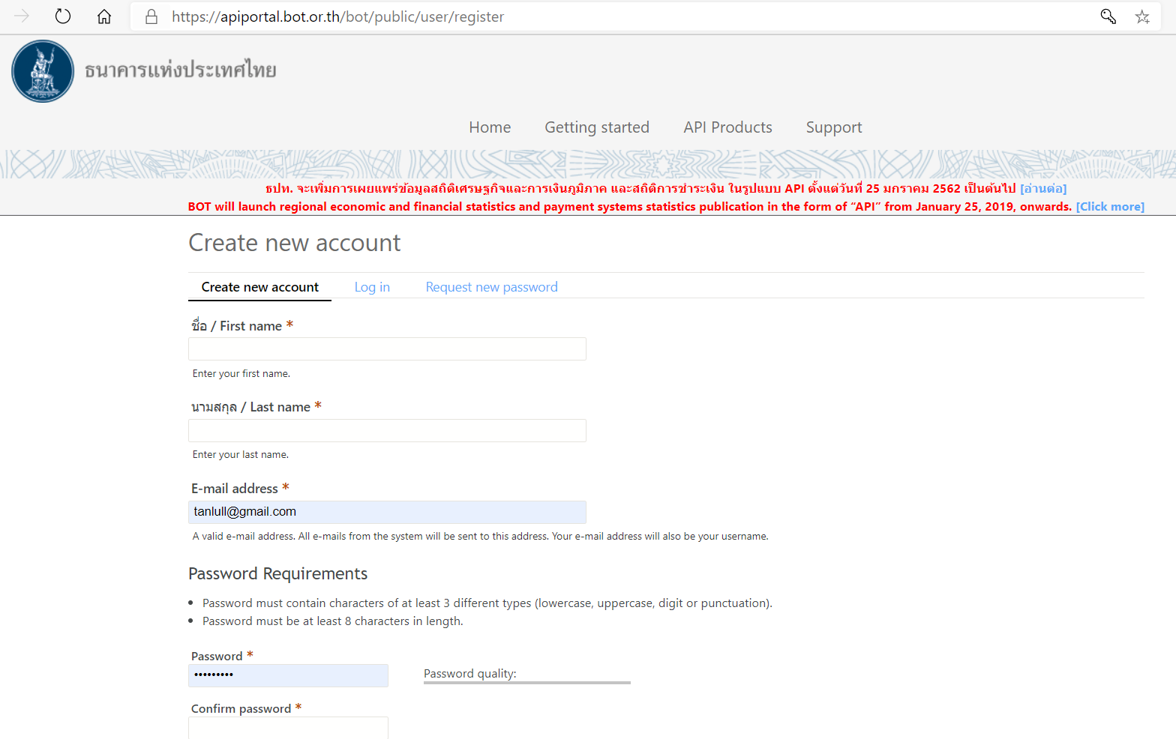
BOT API
https://apiportal.bot.or.th/bot/public/user/register

Slide 56
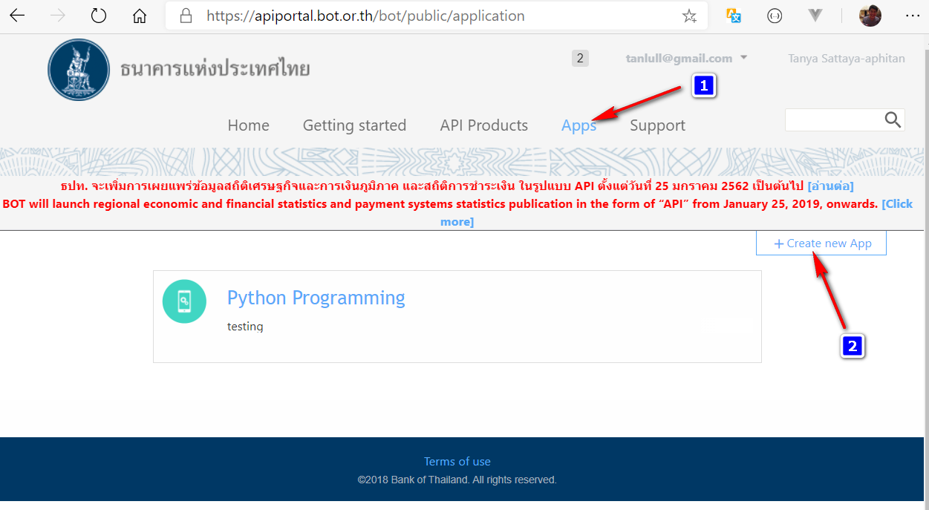
Register API

Slide 57
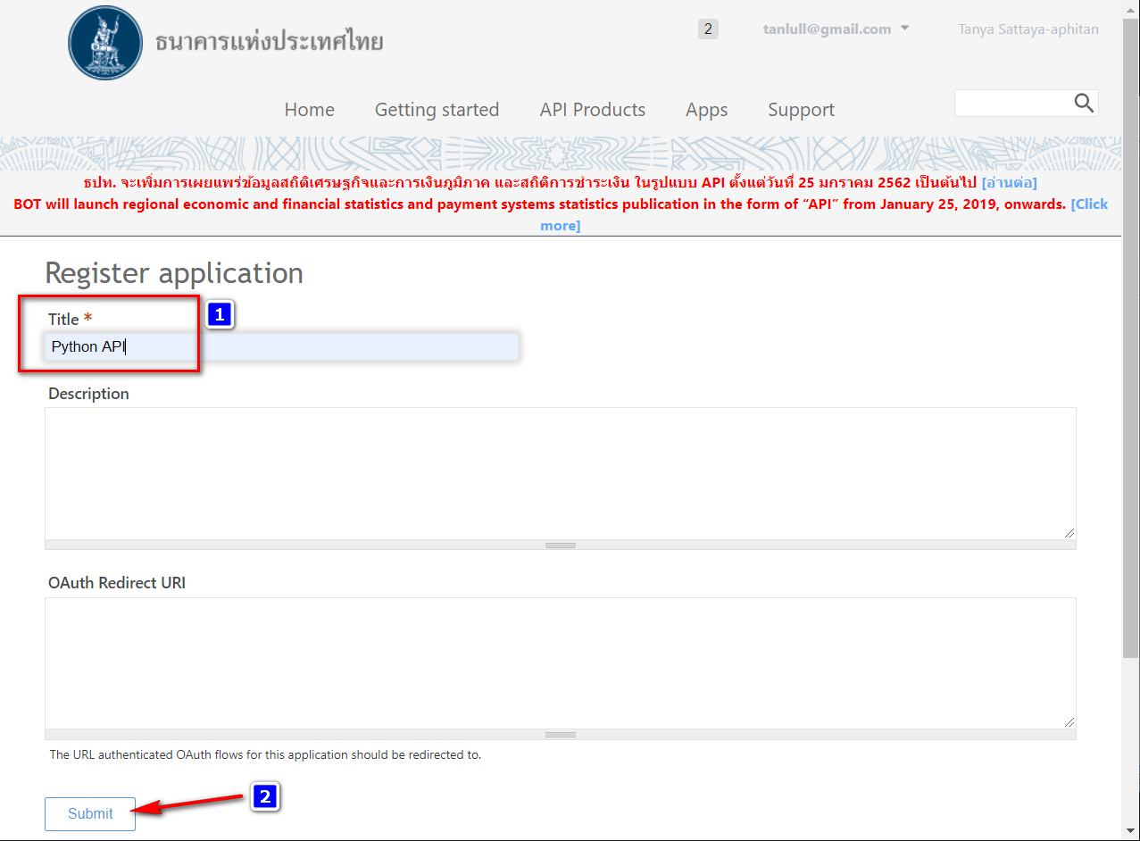
Register Application : Python API

Slide 58
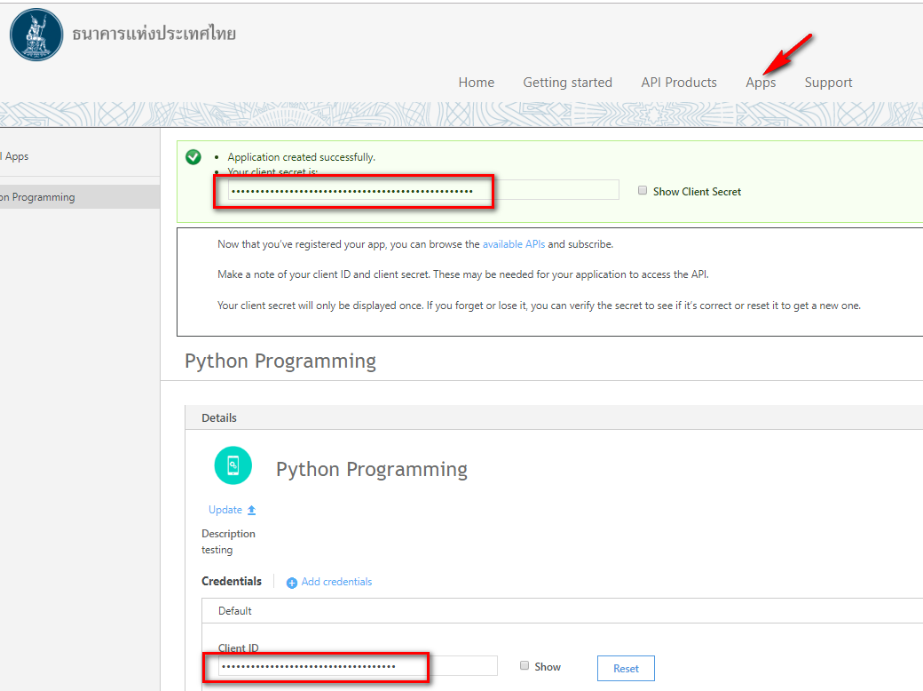
Copy Client ID to field in the next step : 1edd90f8-f587-4e21-9433-81db0f322825

Slide 59
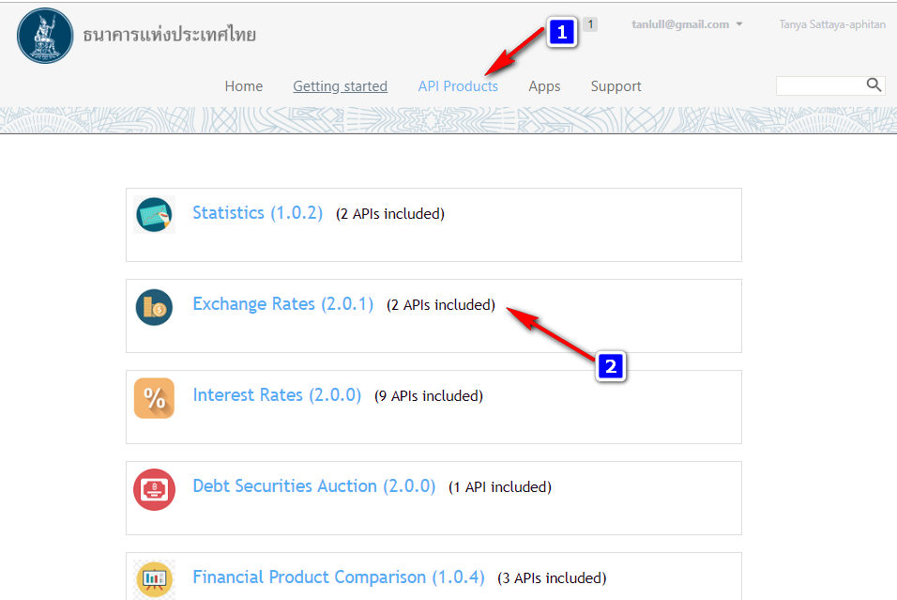
Activate API

Slide 60

Activate API

Slide 61

Browse API

Slide 62

Code Example
Client ID from previous step : 1edd90f8-f587-4e21-9433-81db0f322825

Slide 63
Request API -- BOT_API_Daily.py
import http.client
conn = http.client.HTTPSConnection("apigw1.bot.or.th")
headers = {
'x-ibm-client-id': "1edd90f8-f587-4e21-9433-81db0f322825",
'accept': "application/json"
}
conn.request("GET", "/bot/public/Stat-ReferenceRate/v2/DAILY_REF_RATE/?start_period=2018-10-01&end_period=2018-10-31", headers=headers)
res = conn.getresponse()
data = res.read()
print(data.decode("utf-8"))

Slide 64
Response JSON
{
"result":{
"timestamp":"2018-11-04 09:35:56",
"api":"Daily Weighted-average Interbank Exchange Rate - THB / USD",
"data":{
"data_header":{
"report_name_eng":"Rates of Exchange of Commercial Banks in Bangkok Metropolis (2002-present)",
"report_name_th":"อัตราแลกเปลี่ยนเฉลี่ยของธนาคารพาณิชย์ในกรุงเทพมหานคร (2545-ปัจจุบัน)",
"report_uoq_name_eng":"(Unit : Baht / 1 Unit of Foreign Currency)",
"report_uoq_name_th":"(หน่วย : บาท ต่อ 1 หน่วยเงินตราต่างประเทศ)",
"report_source_of_data":[
{
"source_of_data_eng":"Bank of Thailand",
"source_of_data_th":"ธนาคารแห่งประเทศไทย"
}
],
"report_remark":[
],
"last_updated":"2018-11-02"
},
"data_detail":[
{
"period":"2018-10-31",
"rate":"33.2660000"
},
{
"period":"2018-10-30",
"rate":"33.2700000"
},
{
"period":"2018-10-29",
"rate":"33.1360000"
},
{
"period":"2018-10-26",
"rate":"33.0290000"
},
{
"period":"2018-10-25",
"rate":"32.9230000"
},
{
"period":"2018-10-24",
"rate":"32.8110000"
},
{
"period":"2018-10-03",
"rate":"32.3380000"
},
{
"period":"2018-10-02",
"rate":"32.3380000"
},
{
"period":"2018-10-01",
"rate":"32.2530000"
}
]
}
}
}

Slide 65

Format Response to DataFrame
pip install pandas
import pandas as pd
j=pd.io.json.loads(data)
df=pd.DataFrame(j['result']['data']['data_detail'])
#แปลงให้เป็น Type DateTime
df.period= pd.to_datetime(df.period)
#แปลงให้เป็น Type Numeric
df.rate= pd.to_numeric(df.rate)
print(df)

Slide 66

Plot graph
pip install matplotlib
import matplotlib.pyplot as plt #plot graph เส้น และกาหนดขนาดของเส้น
plt.plot(df.period,df.rate, linewidth=1) #กำหนด Description แต่ละเส้นพร้อมบอกตาแหน่งที่แสดง
plt.legend(["Line 1"], loc="upper right")
plt.show()

Slide 67

Request API Lab 1
Create BOT_API_Monthly.py
Using
Retrieve data from January 2017 to September 2020
Print data
Plot Graph

Slide 68
Test with postman

Slide 69

Test with Postman
https://www.postman.com/downloads/

Slide 70

Get Endpoint

Slide 71

Extract Information
Method: GET
Endpoint: https://apigw1.bot.or.th/bot/public/Stat-ReferenceRate/v2/DAILY_REF_RATE/?start_period=REPLACE_THIS_VALUE&end_period=REPLACE_THIS_VALUE
Header: accept: application/json
x-ibm-client-id: 1edd90f8-f587-4e21-9433-81db0f322825

Slide 72

Postman

Slide 73

New Collection

Slide 74

Add Request

Slide 75

GET / URI

Slide 76


Response

Slide 77
AI 4 Thai API

Slide 78

Request API Lab 2
https://aiforthai.in.th/

Slide 79

Sentiment Analysis

Slide 80

Python Example

Slide 81

Output

Slide 82

API Lab 2
Make your own sentiment analysis
Test Sentiment with Postman
Try another API.

Slide 83
Day 2

Slide 84
Database (MySQL)

Slide 85
Install Mysql Python library
pip install mysql-connector-python

Slide 86
Prepare Database (Postgres)
Create database api;
Use api;
create table source(
id int4,
name text,
age int4,
gender text
);
insert into source values(1,'สมปอง',20,'male');
insert into source values(2,'สมชาย',22,'male');
insert into source values(3,'สมศรี',23,'female');
insert into source values(4,'สมสมร',24,'female');
commit;
select * from source

Slide 87

Result

Slide 88
Select -- select_mysql.py
import mysql.connector as mysql
try:
#Connection
conn = mysql.connect(user='root', password='toor',host='127.0.0.1',database='api')
cursor = conn.cursor()
#Select from database
sql = "select * from source"
cursor.execute(sql)
records = cursor.fetchall()
for row in records:
print ("Id = {0} , Name = {1}, Age = {2}, Gender = {3}".format(row[0],row[1],row[2],row[3]))
except (Exception, mysql.Error) as error :
print ("Error while fetching data from Mysql.", error)
finally:
#closing database connection.
if(conn):
cursor.close()
conn.close()
print("MySQL connection is closed")
Notes:
REf: https://pynative.com/python-postgresql-select-data-from-table/

Slide 89
Insert -- insert_mysql.py
import psycopg2 as pg
try:
conn = pg.connect(user="postgres",password="postgres",host="127.0.0.1",port="5432",database="postgres")
cursor = conn.cursor()
insert_sql = "insert into source values(%s,%s,%s,%s)"
data_to_insert = (5, 'สมเจตน์', 25,'male')
cursor.execute(insert_sql, data_to_insert)
conn.commit()
count = cursor.rowcount
print (count, "Record inserted successfully into source table")
except (Exception, pg.Error) as error :
if(conn):
print("Failed to insert record into source table", error)
finally:
#closing database connection.
if(conn):
cursor.close()
conn.close()
print("PostgreSQL connection is closed")
https://raw.githubusercontent.com/tanlull/Python-Postgres-Mysql/master/insert_postgres.py

Slide 90
Update -- update_mysql.py
import mysql.connector as mysql
def updateTable(id, newid):
try:
conn = mysql.connect(user='root', password='toor',
host='127.0.0.1', database='api')
cursor = conn.cursor()
sql_update = "Update source set id = %s where id = %s"""
cursor.execute(sql_update, (newid, id))
conn.commit()
count = cursor.rowcount
print(count, "Record Updated successfully ")
except (Exception, pg.Error) as error:
print("Error in update operation", error)
finally:
# closing database conn.
if (conn):
cursor.close()
conn.close()
print("PostgreSQL conn is closed")
updateTable(5, 10)

Slide 91
Delete -- delete_mysql.py
import mysql.connector as mysql
def deleteData(id):
try:
conn = mysql.connect(user='root', password='toor',
host='127.0.0.1', database='api')
cursor = conn.cursor()
# Update single record now
sql_delete_query = "Delete from source where id = %s"
cursor.execute(sql_delete_query, (id,))
conn.commit()
count = cursor.rowcount
print(count, "Record deleted successfully ")
except (Exception, pg.Error) as error:
print("Error in Delete operation", error)
finally:
# closing database conn.
if (conn):
cursor.close()
conn.close()
print("PostgreSQL conn is closed")
deleteData(10)

Slide 92
Put it all together

Slide 93
Put it on together (Part 1) -- crud_mysql.py
import mysql.connector as mysql
conn = {};
cursor = {};
def connect():
global conn,cursor
try:
conn = mysql.connect(user='root', password='toor',
host='127.0.0.1',
database='api')
cursor = conn.cursor()
cursor.execute('SET NAMES utf8;')
cursor.execute('SET CHARACTER SET utf8;')
cursor.execute('SET character_set_connection=utf8;')
return True
except (Exception, mysql.Error) as error:
print("Error ", error)
return False
def close():
global conn,cursor
if(conn):
cursor.close()
conn.close()
print("---- closed connection --")
def selectAll():
global conn,cursor
try:
sql = "select * from source"
cursor.execute(sql)
records = cursor.fetchall()
for row in records:
print ("Id = {0} , Name = {1}, Age = {2}, Gender = {3}".format(row[0],row[1],row[2],row[3]))
except (Exception, mysql.Error) as error :
print ("Error while fetching data from Mysql.", error)

Slide 94
Put it on together (Part 2)-- crud_mysql.py
def insert(data_to_insert):
global conn,cursor
try:
insert_sql = "insert into target values(%s,%s,%s,%s)"
#data_to_insert = (5, 'สมเจตน์', 25,'male')
cursor.execute(insert_sql, data_to_insert)
conn.commit()
count = cursor.rowcount
except (Exception, mysql.Error) as error :
print ("Error while fetching data from Mysql.", error)
def updateTable(id, newid):
global conn,cursor
try:
sql_update = "Update target set id = %s where id = %s"""
cursor.execute(sql_update, (newid,id))
conn.commit()
count = cursor.rowcount
print(count, "Record Updated successfully ")
except (Exception, mysql.Error) as error:
print("Error in update operation", error)
def deleteData(id):
global conn,cursor
try:
cursor = conn.cursor()
sql_delete_query = "Delete from target where id = %s"
cursor.execute(sql_delete_query, (id,))
conn.commit()
count = cursor.rowcount
print(count, "Record deleted successfully ")
except (Exception, mysql.Error) as error:
print("Error in Delete operation", error)

Slide 95
Call from other file

Slide 96
Put it on together (Part 3)-- test_mysql.py
import crud_mysql as my
my.connect()
data_to_insert = (6, 'สมเจตน์', 26,'male')
my.insert(data_to_insert)
#my.updateTable(6,10)
#my.deleteData(10)
my.selectAll()
my.close()

Slide 97
Flask

Slide 98
Prepare Environment
pip install flask

Slide 99



API summary
{
"age": "25",
"name": "jan"
}
Request
Client
Server
Dictionary
{
"age": "25",
"gender": "male",
"name": "คุณ jan"
}
json
Response

Slide 100
Request with json

Slide 101

Flask API : flask_echo.py
from flask import Flask, request, jsonify
import json
app = Flask(__name__)
#test
@app.route('/echo', methods=['POST','GET'])
def foo():
data = request.json
print(type(data))
print()
print("------------------------- ECHO --------------------------")
print(data)
print("---------------------------------------------------------")
return jsonify(data)
if __name__ == '__main__':
app.run(debug=True, port=80, host='0.0.0.0')

Slide 102

Run & Allow Access

Slide 103

Test with Postman

Slide 104

Recall dictionary data type :
dictionary_test.py
# dictionary
data = {'age':'25', 'name':'เจน'}
print(type(data))
#Access Dictionary
print(data["name"])
#Modify Dict
data["name"] = "นุ่น"
print(data["name"])
# add dict
data["friend"] = "โบ"
print(data)
#delete dict
del data["friend"]
print(data)

Slide 105

To Stop Running Server -> Ctrl+C

Slide 106
Add data : flask_add_data.py
from flask import Flask, request, jsonify
import json
app = Flask(__name__)
#test
@app.route('/echo', methods=['POST','GET'])
def foo():
data = request.json
data["gender"] = "male"
print()
print("------------------------- ECHO --------------------------")
print(data)
print("---------------------------------------------------------")
return jsonify(data)
if __name__ == '__main__':
app.run(debug=True, port=80, host='0.0.0.0')

Slide 107

Test with Postman

Slide 108
Modify data : flask_add_data.py
from flask import Flask, request, jsonify
import json
app = Flask(__name__)
#test
@app.route('/echo', methods=['POST','GET'])
def foo():
data = request.json
data["gender"] = "male"
data["name"] = "คุณ" + data["name"]
print()
print("------------------------- ECHO --------------------------")
print(data)
print("---------------------------------------------------------")
return jsonify(data)
if __name__ == '__main__':
app.run(debug=True, port=80, host='0.0.0.0')

Slide 109

Test with Postman

Slide 110
Request with parameter

Slide 111

flask_parameter.py
from flask import Flask, request, jsonify
import json
app = Flask(__name__)
@app.route('/test', methods=['POST','GET'])
def bar():
data = request.args
print()
print(type(data))
print("------------------- Get Parameters---------------------")
print(data)
print("---------------------------------------------------------")
return jsonify(data)
if __name__ == '__main__':
app.run(debug=True, port=80, host='0.0.0.0')

Slide 112

Test with Postman

Slide 113
ImmutableMultiDict -> Dict
from flask import Flask, request, jsonify
app = Flask(__name__)
@app.route('/test', methods=['POST','GET'])
def bar():
data = request.args.to_dict()
print()
print(type(data))
data["gender"] = "male"
data["name"] = "คุณ " + data["name"]
print("------------------- Get Parameters---------------------")
print(data)
print("---------------------------------------------------------")
return jsonify(data)
if __name__ == '__main__':
app.run(debug=True, port=80, host='0.0.0.0')

Slide 114

Test with Postman

Slide 115
Your First API (MySQL)

Slide 116

API summary
{
"age": "25",
"name": "jan"
}
Request
Client
Server
Database
Dictionary
SQL
{
"age": "25",
"gender": "male",
"name": "คุณ jan"
}
recordset
json
Response

Slide 117
Create MySQL Library : mysql_lib.py
import mysql.connector as mysql
conn = {}
cursor = {}
def connect():
global conn, cursor
try:
conn = mysql.connect(user='root', password='toor',host='127.0.0.1', database='api')
cursor = conn.cursor()
return True
except (Exception, mysql.Error) as error:
print("Error ", error)
return False
def close():
global conn, cursor
if(conn):
cursor.close()
conn.close()
print("---- closed connection --")
def select(sql):
global conn, cursor
try:
cursor.execute(sql)
data = list2dict(cursor)
return data
except (Exception, mysql.Error) as error:
print("Error while fetching data from Mysql.", error)
def list2dict(cursor):
desc = cursor.description
column_names = [col[0] for col in desc]
data_dict = [dict(zip(column_names, row)) for row in cursor.fetchall()]
return data_dict
def executeSQL(sql):
global conn, cursor
data = {}
try:
cursor.execute(sql)
conn.commit()
count = cursor.rowcount
data["status"] = "Success"
data["count"] = count
return data
except (Exception, mysql.Error) as error:
print("Error while fetching data from Mysql.", error)
data["status"] = "Error"
data["message"] = str(error)
finally:
return data

Slide 118

Select All : flask_api_mysql.py
from flask import Flask, request, jsonify
import mysql_lib
app = Flask(__name__)
@app.route('/all', methods=['POST','GET'])
def all():
result = db_get_all()
return jsonify(result)
def db_get_all():
mysql_lib.connect()
sql = "select * from source"
data = mysql_lib.select(sql)
mysql_lib.close()
return data
if __name__ == '__main__':
app.run(debug=True, port=80, host='0.0.0.0')

Slide 119

Select by ID : flask_api_mysql.py
@app.route('/by_id', methods=['POST','GET'])
def by_id():
data = request.args
id = data["id"]
result = db_get_by_id(id)
return jsonify(result)
def db_get_by_id(id):
mysql_lib.connect()
sql = "select * from source where id={}".format(id)
print(sql)
data = mysql_lib.select(sql)
mysql_lib.close()
return data

Slide 120
Insert : Append to
flask_api_mysql.py
mysql_lib.py
@app.route('/insert', methods=['POST','GET'])
def insert():
data = request.args
result = db_insert(data["id"],data["name"],data["age"],data["gender"])
return jsonify(result)
def db_insert(id,name,age,gender):
mysql_lib.connect()
insert_sql = "insert into source values('{}','{}','{}','{}')".format(id,name,age,gender)
print(insert_sql)
data = mysql_lib.executeSQL(insert_sql)
mysql_lib.close()
return data
def executeSQL(sql):
global conn, cursor
data = {}
try:
cursor.execute(sql)
conn.commit()
count = cursor.rowcount
data["status"] = "Success"
data["count"] = count
return data
except (Exception, mysql.Error) as error:
print("Error while fetching data from Mysql.", error)
data["status"] = "Error"
data["message"] = str(error)
finally:
return data

Slide 121


Insert
Success
Fail

Slide 122

Update : Append to
flask_api_mysql.py
# Update
@app.route('/update', methods=['POST','GET'])
def update():
data = request.args
result = db_update(data["id"],data["name"])
return jsonify(result)
def db_update(id,name):
mysql_lib.connect()
sql = "update source set name='{}' where id ={}".format(name,id)
print(sql)
data = mysql_lib.executeSQL(sql)
mysql_lib.close()
return data

Slide 123

Delete : Append to
flask_api_mysql.py
# Delete
@app.route('/delete', methods=['POST','GET'])
def delete():
data = request.args
result = db_delete(data["id"])
return jsonify(result)
def db_delete(id):
mysql_lib.connect()
sql = "delete from source where id ={}".format(id)
print(sql)
data = mysql_lib.executeSQL(sql)
mysql_lib.close()
return data

Slide 124
Access our own API via Python

Slide 125

import requests
URL = "http://localhost/all"
r = requests.get(url = URL)
data = r.json()
print(data)
print("------ 1 -------")
print(data[1])
print("----- 2 --------")
print(data[2])
print(data[2]["age"])
print(data[2]["name"])
print("----- Loop --------")
for d in data:
print(d)
print("----------END LOOOP-------")
flask_api_call.py
Run with new Terminal!

